Slide 1
Swarm and Evolutionary Computation
Joaquín Derrac, Salvador García , Daniel Molina, Francisco Herrera
Iustin Petrisor Alexandru Sarbu

Slide 2
Purpose of research
To provide a practical tutorial on the use of nonparametric statistical tests as a methodology for comparing evolutionary and swarm intelligence algorithms

Slide 3
Introduction
In recent years, the use of statistical tests to improve the evaluation process of the performance of a new method has become a widespread technique in computational intelligence.
Statistical procedures developed to perform statistical analyses can be categorized into two classes: parametric and nonparametric, depending on the concrete type of data employed.
Parametric tests have been commonly used in the analysis of experiments in computational intelligence. Unfortunately, they are based on assumptions which are most probably violated when analyzing the performance of stochastic algorithms based on computational intelligence.

Slide 4
Introduction Benchmark functions
5 unimodal functions
F1: Shifted Sphere Function.
F2: Shifted Schwefel’s Problem 1.2.
F3: Shifted Rotated High Conditioned Elliptic Function.
F4: Shifted Schwefel’s Problem 1.2 with Noise in Fitness.
F5: Schwefel’s Problem 2.6 with Global Optimum on Bounds

Slide 5
Introduction Benchmark functions
20 multimodal functions
F6: Shifted Rosenbrock’s Function.
F7: Shifted Rotated Griewank Function without Bounds.
F8: Shifted Rotated Ackley’s Function with Global Optimum on Bounds.
F9: Shifted Rastrigin’s Function.
F10: Shifted Rotated Rastrigin’s Function.
F11: Shifted Rotated Weierstrass Function.
F12: Schwefel’s problem 2.13.
F13: Expanded Extended Griewank’s plus Rosenbrock’s Function (F8F2)
F14: Shifted Rotated Expanded Scaffers F6
11 hybrid functions. Each one (F15 to F25) has been defined through compositions of 10 out of the 14 previous functions (different in each case)

Slide 6
Introduction Evolutionary and swarm intelligence algorithms
PSO: Particle Swarm Optimization
IPOP-CMA-ES: is a restart Covariant Matrix Evolutionary Strategy (CMA-ES) with Increasing Population Size
CHC: the key idea of the CHC algorithm concerns the combination of a selection strategy with a very high selective pressure and several components inducing a strong diversity
SSGA: A real-coded Steady-State Genetic Algorithm
SS-arit & SS-BLX: Two instances of the classic Scatter Search model
DE-Exp & DE-Bin: 2 Classic Differential Evolution models
SaDE: Self-adaptive Differential Evolution

Slide 7
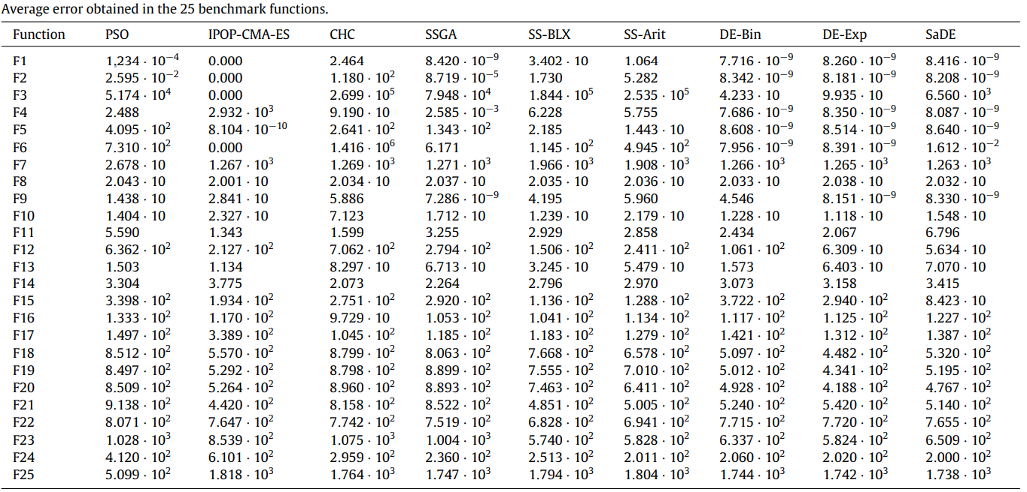
Average error

Slide 8
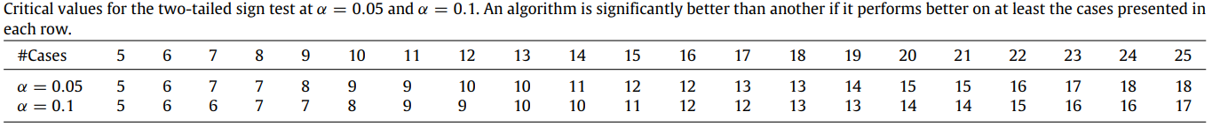
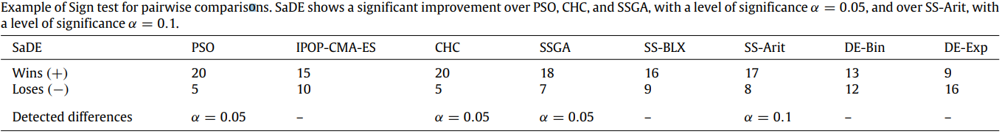
Sign test
A popular way to compare the overall performances of algorithms is to count the number of cases on which an algorithm is the overall winner.
If both algorithms compared are, as assumed under the null hypothesis, equivalent, each should win on approximately n/2 out of n problems.

Slide 9
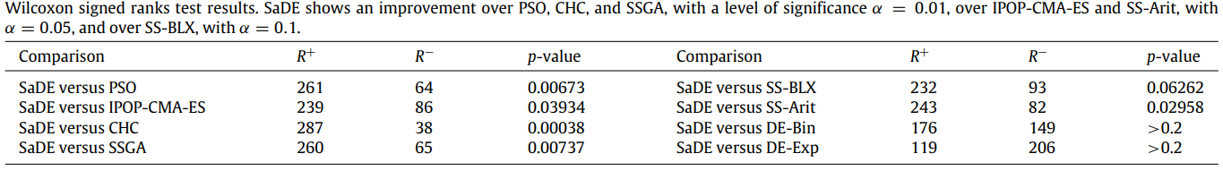
The Wilcoxon signed ranks test
The Wilcoxon signed ranks test is used for answering the following question: do two samples represent two different populations?
The Wilcoxon signed ranks test is more sensitive than the t-test
It assumes commensurability of differences, but only qualitatively: greater differences still count for more, which is probably desired, but the absolute magnitudes are ignored.

Slide 10

Multiple comparisons with a control method
In pairwise analysis, if we try to extract a conclusion involving more than one pairwise comparison, we will obtain an accumulated error coming from its combination. In statistical terms, we are losing the control on the Family-Wise Error Rate (FWER), defined as the probability of making one or more false discoveries among all the hypotheses when performing multiple pairwise tests

Slide 11
Multiple Sign test
Given a control labeled algorithm, the Sign test for multiple comparisons allows us to highlight those ones whose performances are statistically different when compared with the control algorithm.
There is a difference between the Sign test and the Multiple Test caused by the control of the FWER which prevents the rejection of the null hypothesis in some cases

Slide 12
The Friedman
is a nonparametric analog of the parametric two-way analysis of variance.
it can be used for answering the following question: in a set of k samples (where k ≥ 2), do at least two of the samples represent populations with different median values?
the null hypothesis for Friedman’s test states equality of medians between the populations. The alternative hypothesis is defined as the negation of the null hypothesis, so it is nondirectional.

Slide 13
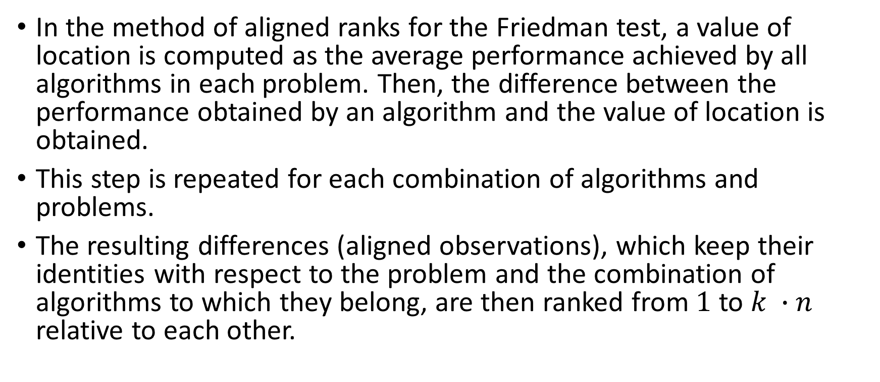
Friedman Aligned Ranks
In the method of aligned ranks for the Friedman test, a value of location is computed as the average performance achieved by all algorithms in each problem. Then, the difference between the performance obtained by an algorithm and the value of location is obtained.
This step is repeated for each combination of algorithms and problems.
The resulting differences (aligned observations), which keep their identities with respect to the problem and the combination of algorithms to which they belong, are then ranked from $1$ to $k ∙n$ relative to each other.

Slide 14
Quade test
This test, in contrast to Friedman’s, considers the fact that some problems are more difficult or that the differences registered on the run of various algorithms over them are larger (the Friedman test considers all problems to be equal in terms of importance).
Therefore, the rankings computed on each problem could be scaled depending on the differences observed in the algorithms’ performances, obtaining, as a result, a weighted ranking analysis of the sample of results.

Slide 15
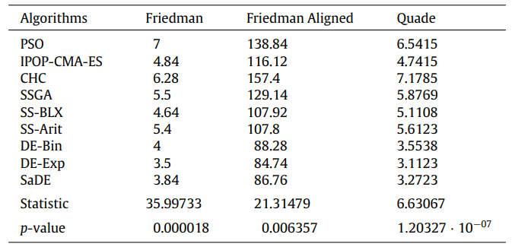
Ranks achieved by the Friedman, Friedman Aligned, and Quade tests
DE-Exp achieves the best rank in the three procedures.

Slide 16
Post-hoc procedures
The main drawback of the Friedman, Friedman Aligned, and Quade tests is that they only can detect significant differences over the whole multiple comparison, being unable to establish proper comparisons between some of the algorithms considered.
The p-value of every hypothesis in the family can be obtained through the conversion of the rankings computed by each test by using a normal approximation.

Slide 17
Post-hoc procedures Adjusted p-values
However, these p-values are not suitable for multiple comparisons. When a p-value is considered in a multiple test, it reflects the probability error of a certain comparison, but it does not consider the remaining comparisons belonging to the family.
Adjusted p-values (APVs) can deal with this problem. Since they consider the family error accumulated, multiple tests can be conducted without disregarding the FWER.
Therefore, their use is recommended since they provide more information in a statistical analysis.

Slide 18


Post-hoc procedures Adjusted p-values
The procedures of p-value adjustment can be classified into several classes:
One-step
The Bonferroni–Dunn procedure:
Step-down
The Holm procedure:
The Holland procedure:
The Finner procedure:
Step-up
The Hochberg procedure:
The Hommel procedure (complex algorithm)
The Rom procedure:
Two-step: The Li procedure

Slide 19
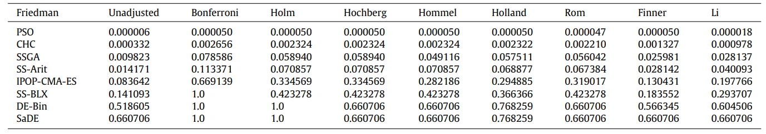
Post-hoc procedures Adjusted p-values for the Friedman test (DE-Exp is the control method).
As we can see in the tables, the Friedman test shows a significant improvement of DE-Exp over PSO, CHC, SSGA, and SS-Arit for all the post-hoc procedures considered, except for the Bonferroni–Dunn one.

Slide 20
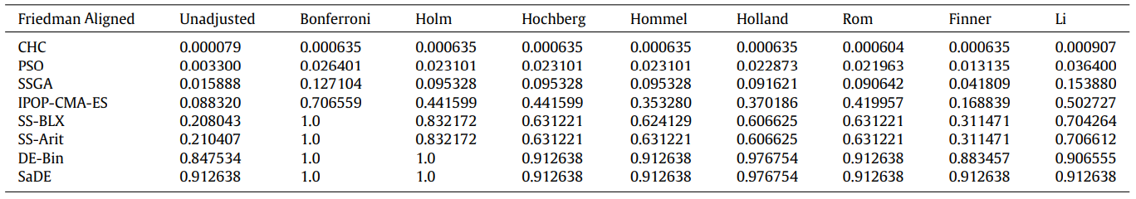
Post-hoc procedures Adjusted p-values for the Friedman Aligned test (DE-Exp is the control method).
The Friedman Aligned test only confirms the improvement of DE-Exp over PSO, CHC, and SSGA for every post-hoc procedure considered, except Bonferroni–Dunn and Li, which fail to highlight the differences between DE-Exp and SSGA as significant

Slide 21
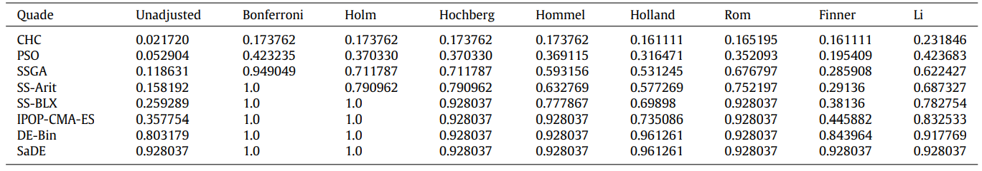
Post-hoc procedures Adjusted p-values for the Quade test (DE-Exp is the control method)
The Quade test does not find any significant difference between DE-Exp and the rest of algorithms.
This result support the conclusion that, although DE-Exp obtains better results than the weaker algorithms of our experimental study (PSO, CHC, and so on), these behave similarly or better in the most difficult problems

Slide 22
General considerations
By using nonparametric statistical procedures, it is possible to analyze any unary performance measure (that is, associated to a single algorithm) with a defined range.
Being able to be applied in multi-domain comparisons, nonparametric statistical procedures can compare both deterministic and stochastic algorithms simultaneously, providing that their results are represented as a sample for each pair of algorithm/domain.

Slide 23
General considerations
For the application of these methods, only a result for each pair of algorithm/domain is required. A known and standardized procedure must be followed to gather them, using average results from several executions when considering stochastic algorithms.
An appropriate number of algorithms in contrast with an appropriate number of case problems are needed to be used in order to employ each type of test. The number of algorithms used in multiple comparisons procedures must be lower than the number of case problems. The previous statement may not be true for the Wilcoxon test. The influence of the number of case problems used is more noticeable in multiple comparison procedures than in Wilcoxon’s test.

Slide 24
Conclusions
In this work, we have shown a complete set of nonparametric statistical procedures and their application to contrast the results obtained in experimental studies of continuous optimization algorithms.
We encourage the use of nonparametric tests whenever there exists a necessity of analyzing results obtained by evolutionary or swarm intelligence algorithms for continuous optimization problems in multi-problem analysis, due to the fact that the initial conditions that guarantee the reliability of the parametric tests are not satisfied.

